Slide 1
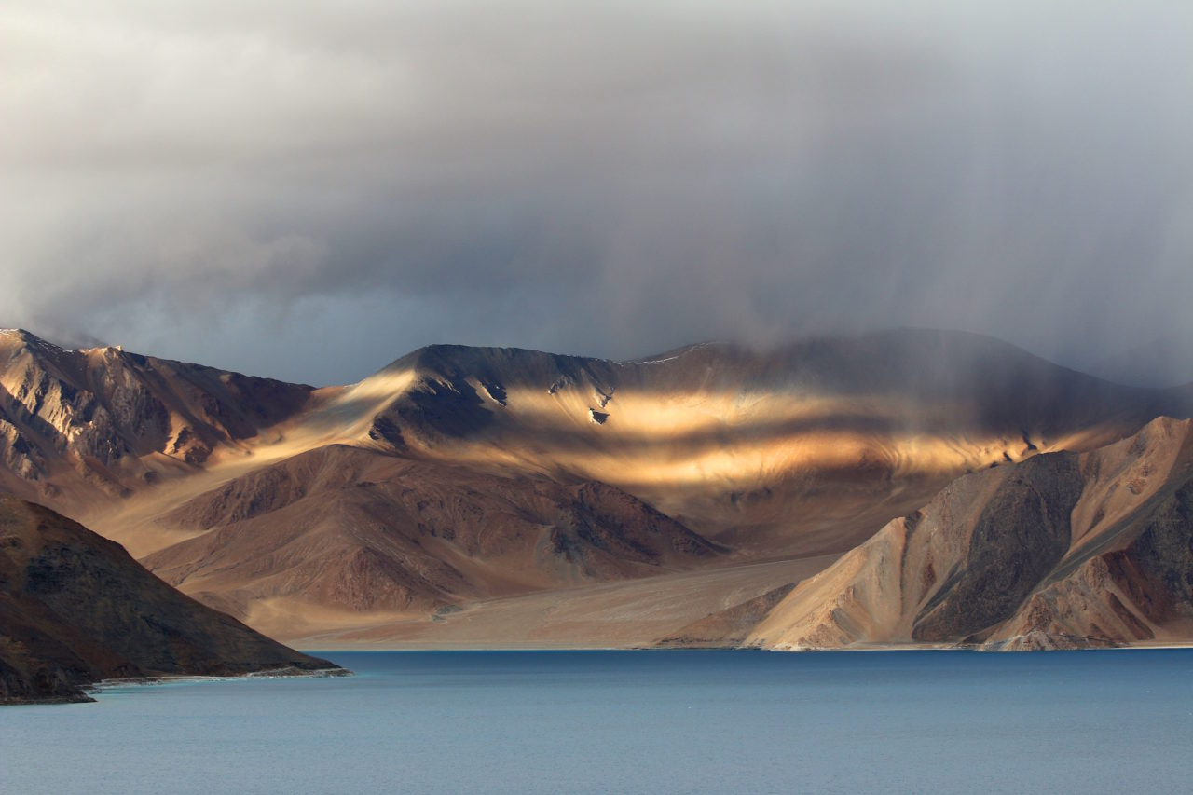
OMAN – 8N/9D
Desert, Sea & mountain

Slide 2
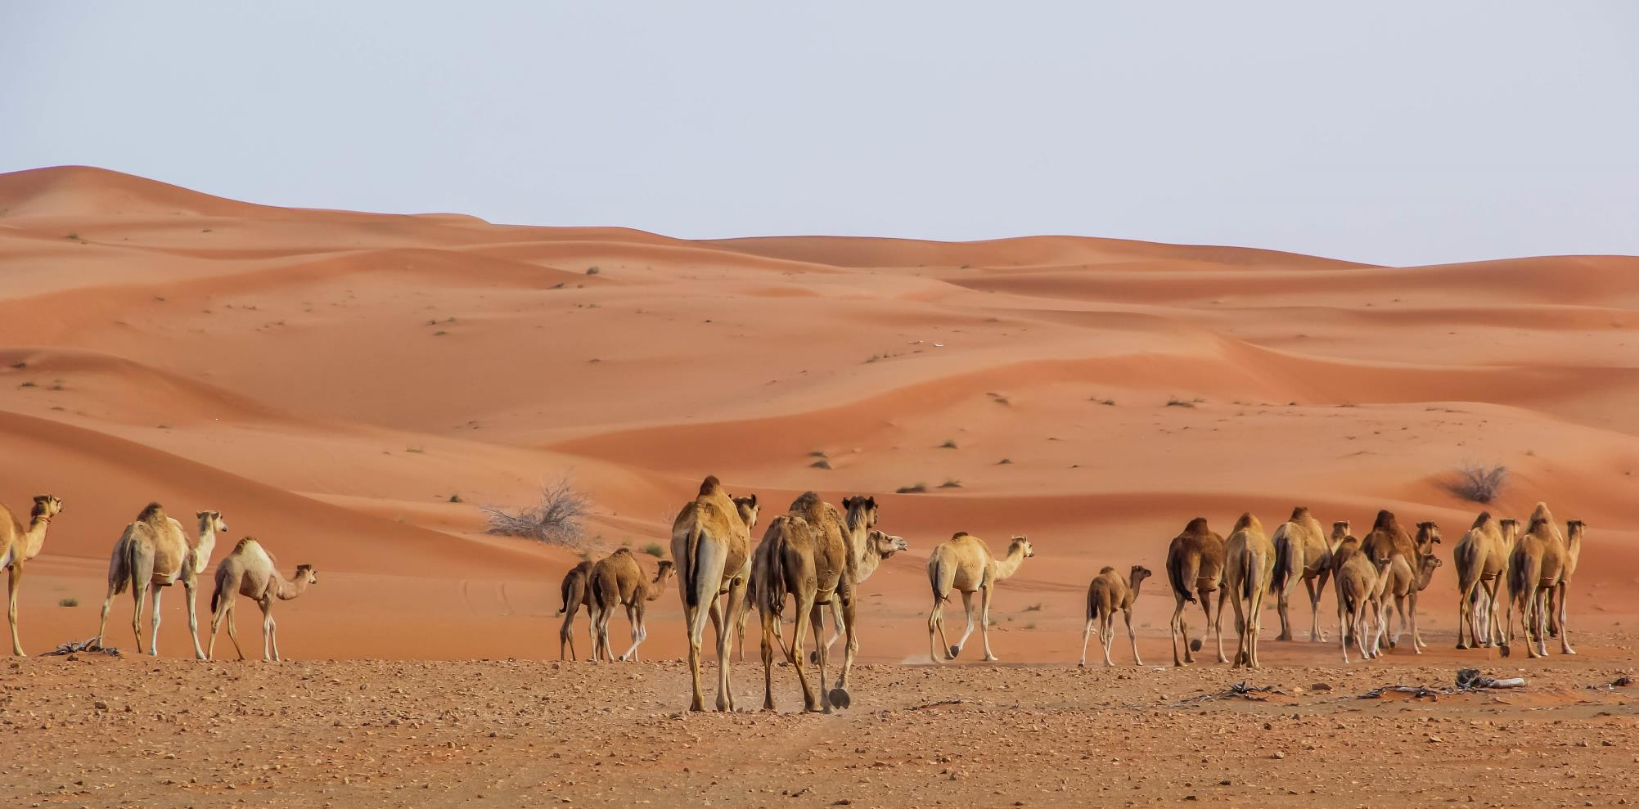
WAHIBA SAND DUNES
Day 1

Slide 3
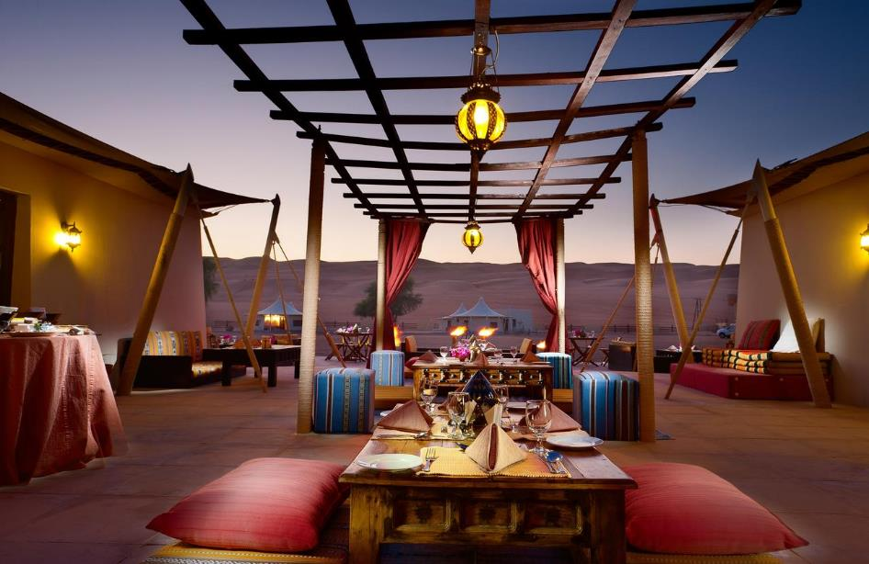
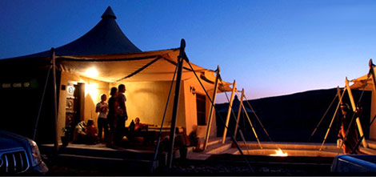
Day 1 of 9
Arrival in Muscat
Meet & Greet at the airport and transfer to Desert Resort in Wahiba Sands
Relax in the Bedouin “majlis” with Omani dates and Arabic coffee
Feast on delicious Omani delicacies
Enjoy your evening in the desert under the stars

Slide 4
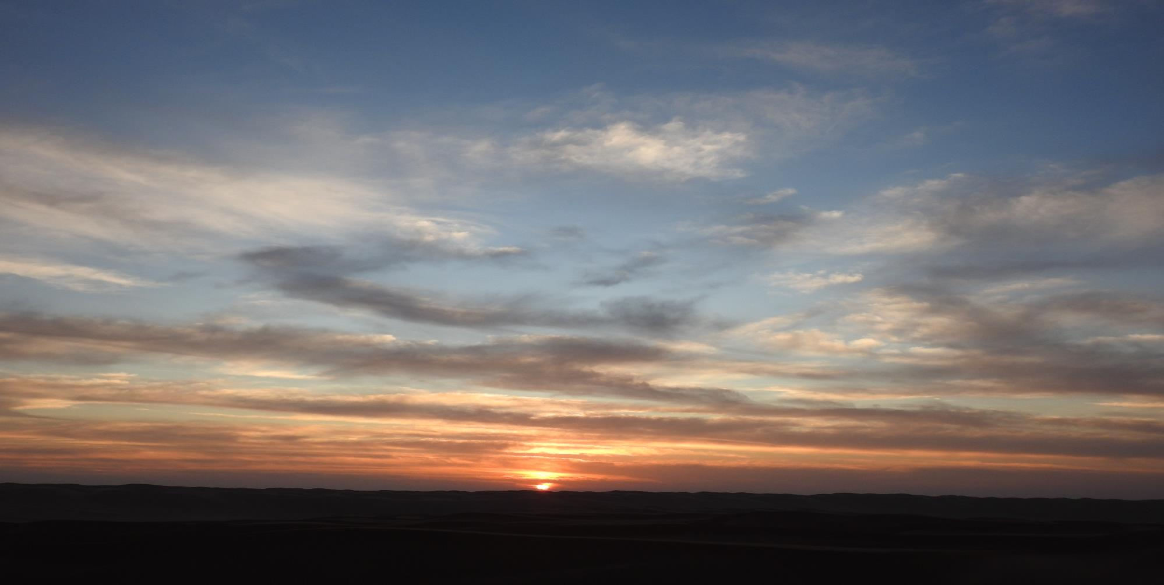
Day 2
Bedouin’s journey – full day camel trek

Slide 5
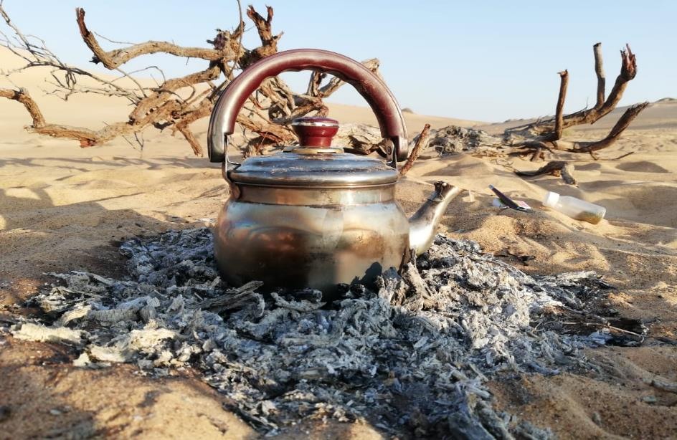
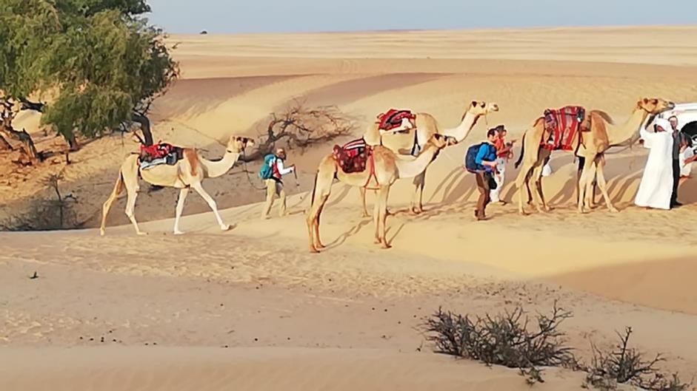
Day 2 of 9
Arise at first light and warm up to the sun rising over the dunes
A sumptuous breakfast follows
Brief guidance by the camel herd leader on how to handle your camel and ride safe
Cross a 25km stretch of Wahiba desert navigating pristine red sand dunes
Set up camp before sunset. Dinner is served here
Your camel herd leader will entertain you with local Bedouin tales before it’s time to sleep
Lunch will be served Enroute

Slide 6
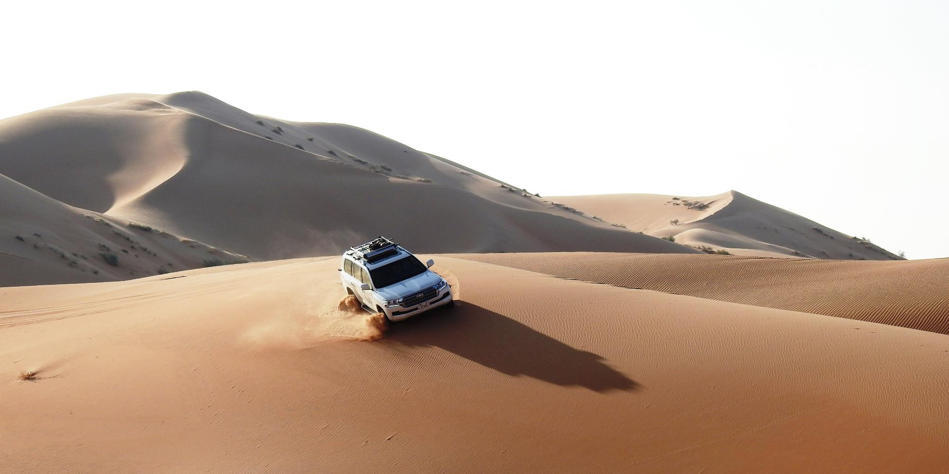
Day 3
wahiba desert crossing | Self-drive expedition

Slide 7
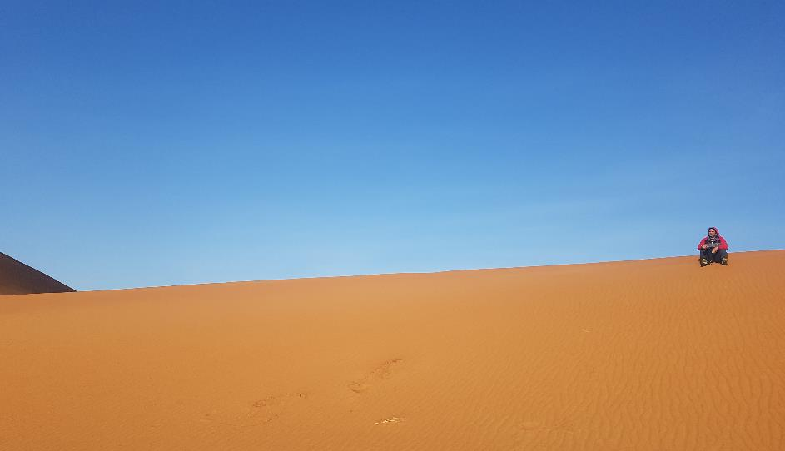
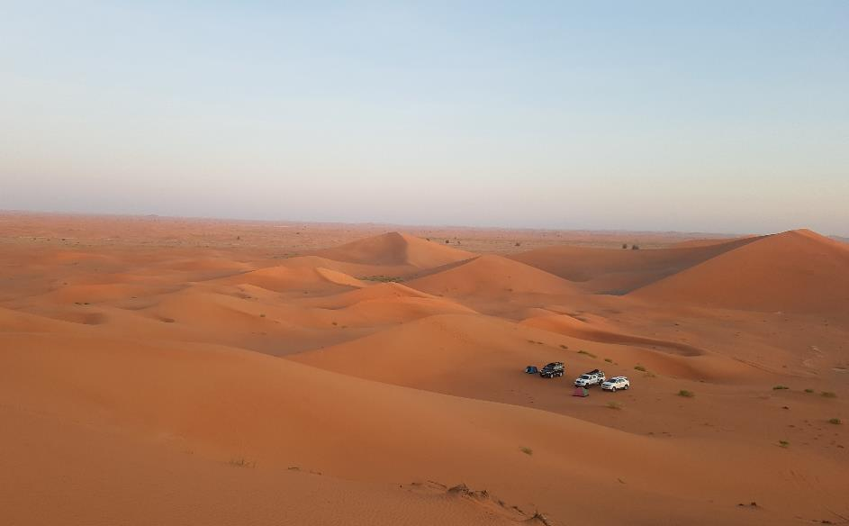
Day 3 of 9
Early morning breakfast at the campsite
Hop aboard your 4X4 off-road vehicle for a self-drive experience
Drive on a desert trail leading to your campsite close to the coast
Lunch will be served Enroute
Arrive at the campsite and set up camp
BBQ Dinner will be served

Slide 8
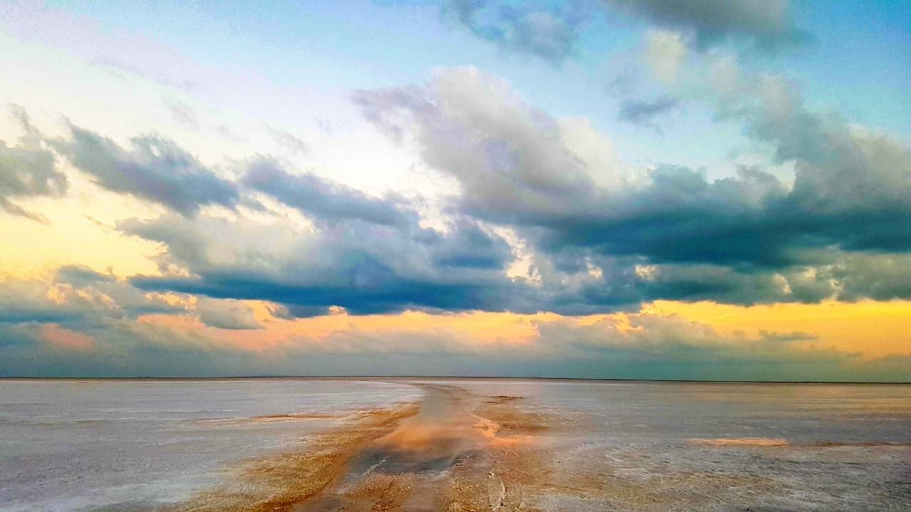
Day 4
BARR AL HIKMAN

Slide 9
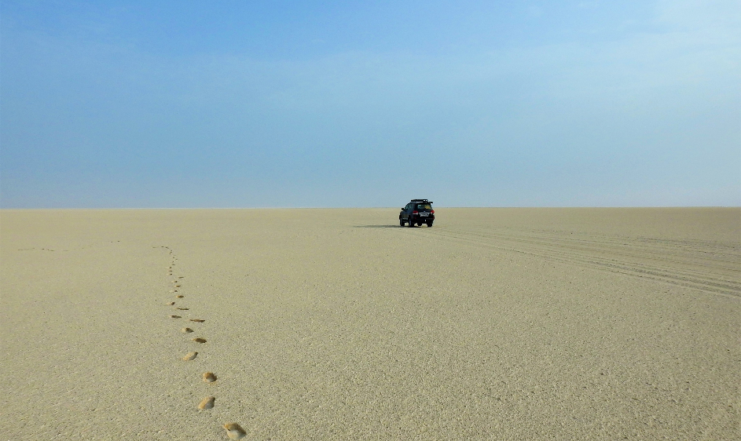
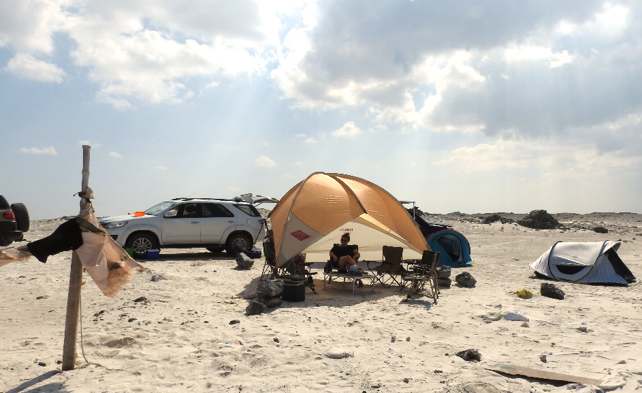
Day 4 of 9
Post breakfast, start your 35km walk through the isolated salt pans
Reach the coast by mid-day and enjoy a swim in the crystal-clear waters of the Indian Ocean
Watch the resident and other migratory birds including flamingos
Set up camp for the evening and feast on a freshly prepared seafood BBQ before calling it a day
Picnic lunch will be served

Slide 10
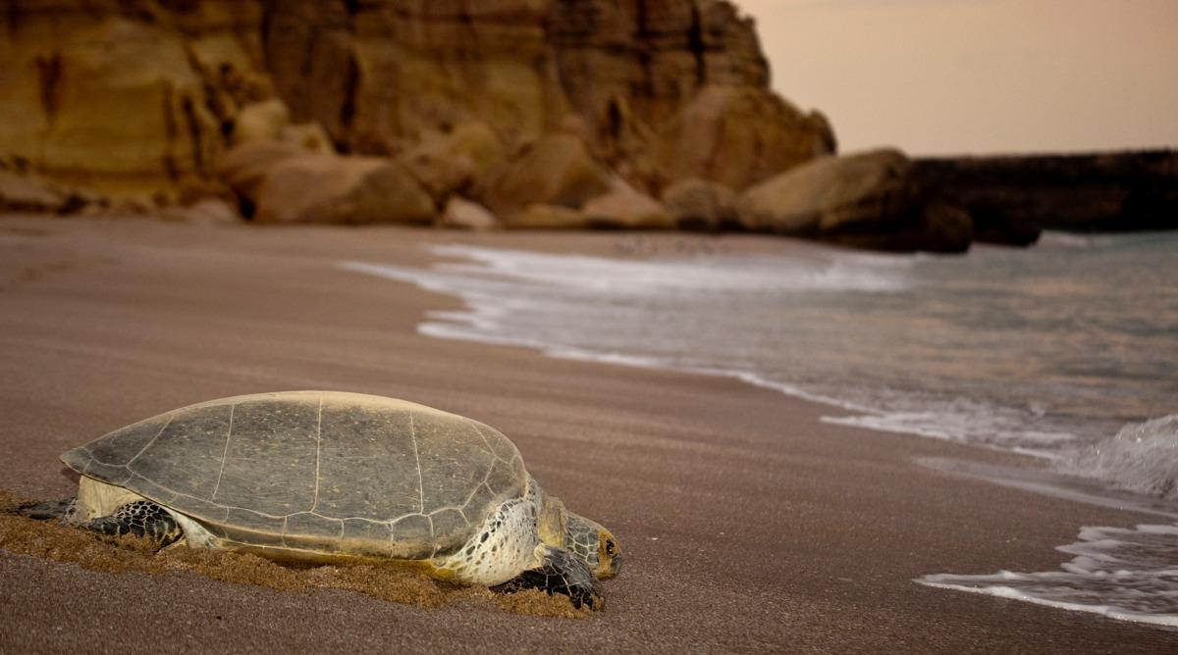
Day 5
Masirah island - 1

Slide 11
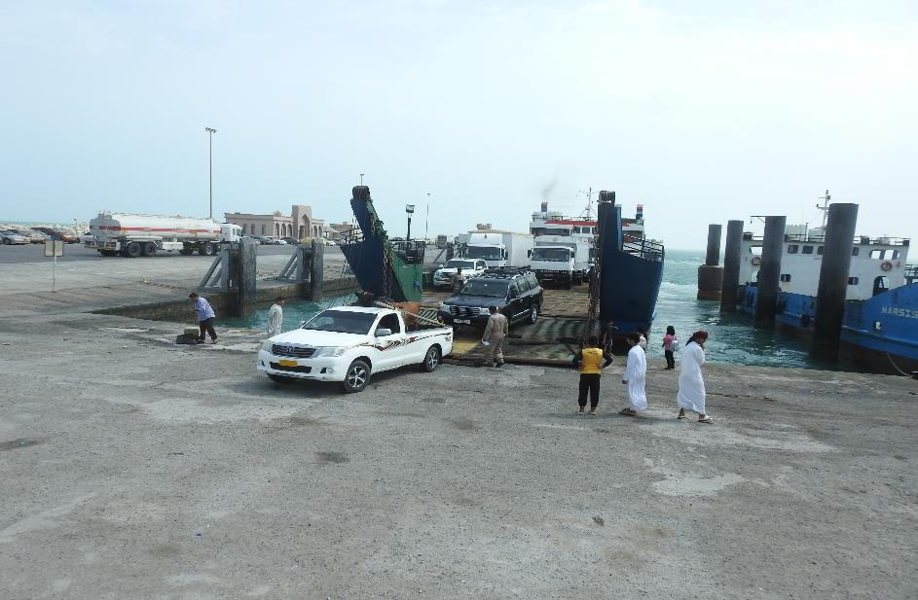
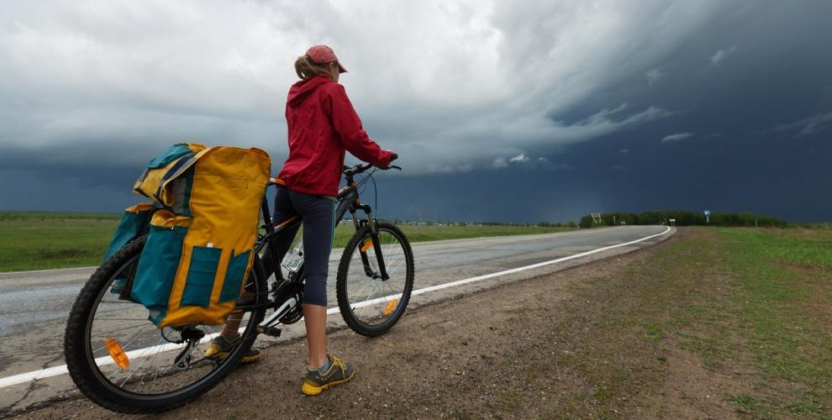
Day 5 of 9
Wake up to the aroma of coffee and prepare for breakfast
Engage in leisure activities such as kayaking, fishing, stand-up paddle or witness the wildlife in the wetland’s eco-system
By mid-day, pack up and head towards Shanna port to catch the ferry to Masirah Island
Lunch will be served on the ferry
Upon reaching the Island, embark with your mountain bikes on a 24km trail leading to the camping area
Set up camp whilst dinner is being prepared and served

Slide 12
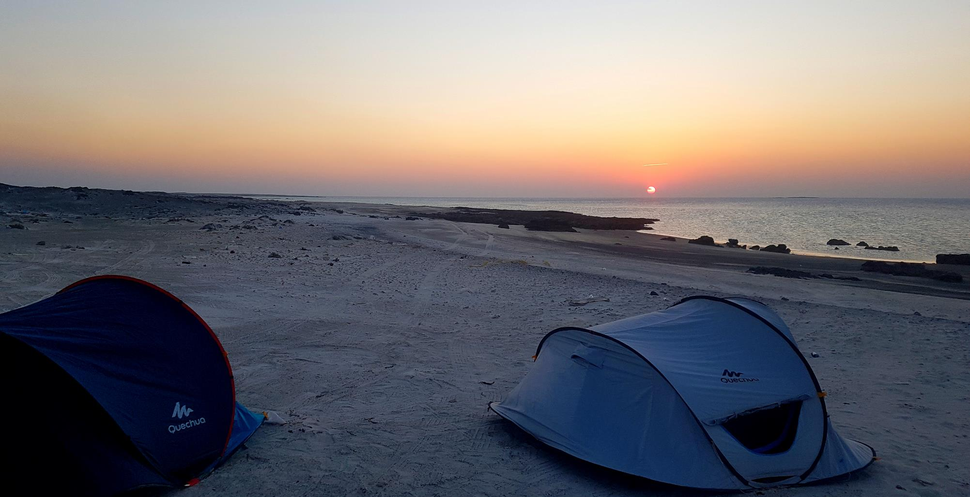
Day 6
Masirah island - 2

Slide 13
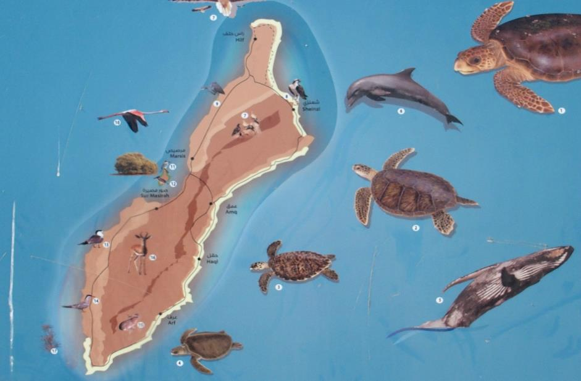
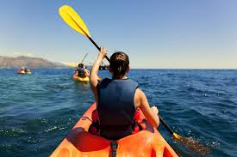
Day 6 of 9
Wake up to the backdrop of an exhilarating island scenery
Post a campsite breakfast head to your kayak
Kayak to the nearby seagull nesting island
An opportunity to spot dolphins, turtles and other sea mammals
Return to the camp for lunch
Drive around Masirah Island soaking in its picturesque locale before checking-in at your hotel
Relax in anticipation of a great dinner ahead of you

Slide 14
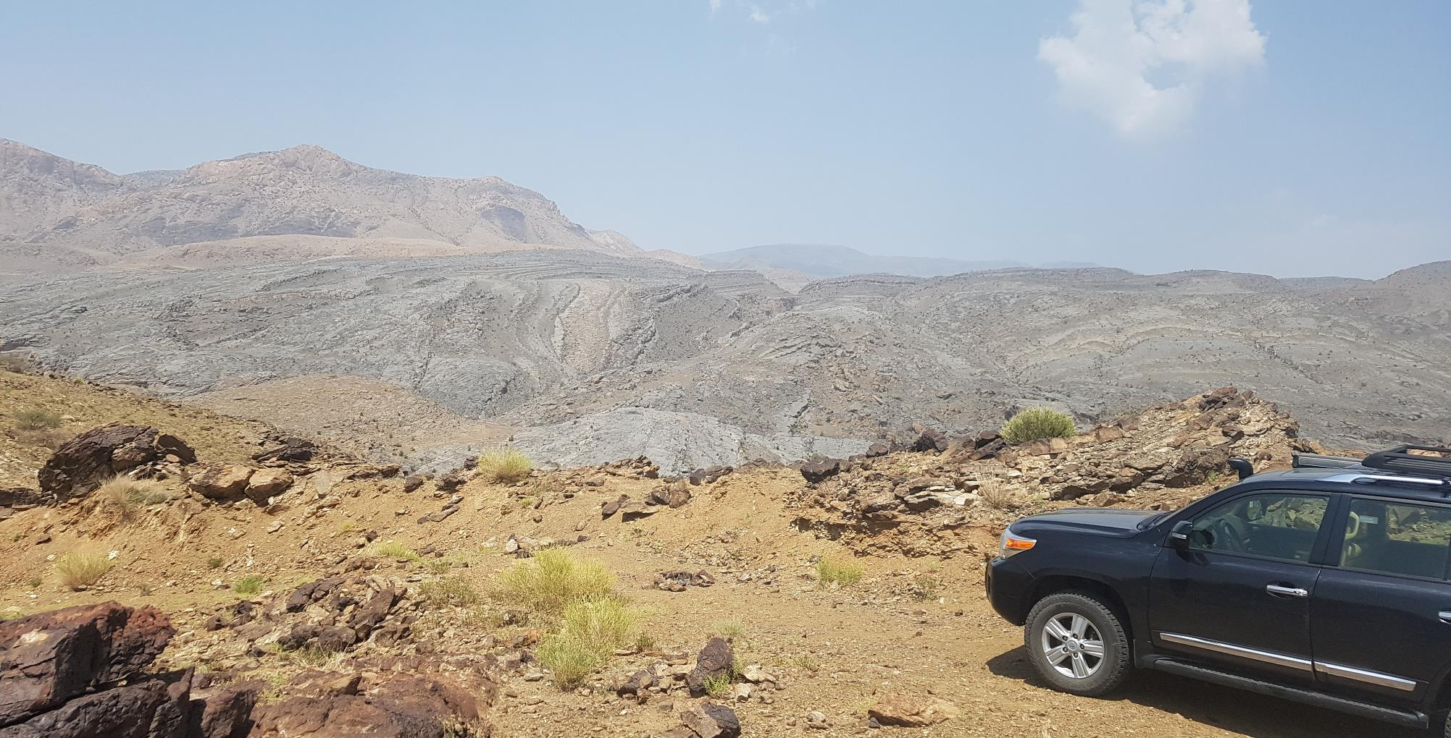
Day 7
Hajar mountains

Slide 15
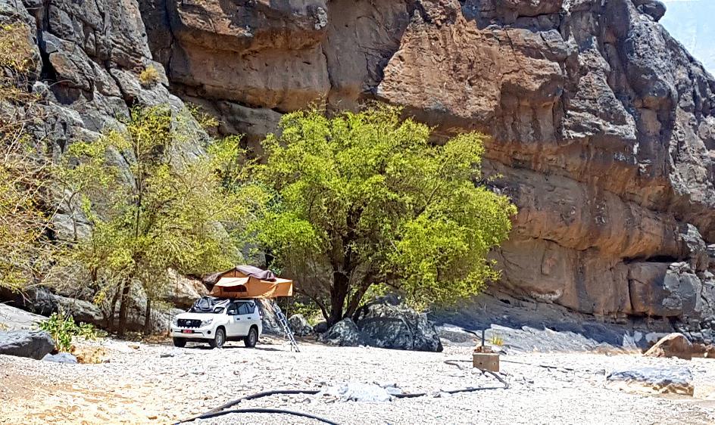
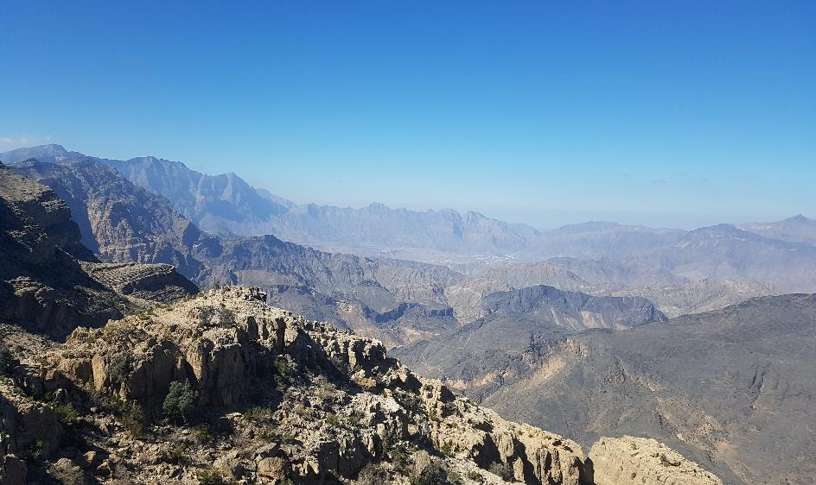
Day 7 of 9
Post breakfast, depart for the ferry
Return to the mainland and drive along the scenic coast
Witness the steep ledged Hajar mountain range, offering breathtaking views
Post lunch, take the winding steep hairpins of the mountains
Set up camp before sunset at a high vantage point overlooking the Salmah plateau
Dinner preparations will be underway
Sleep under the beautiful twinkling night sky

Slide 16
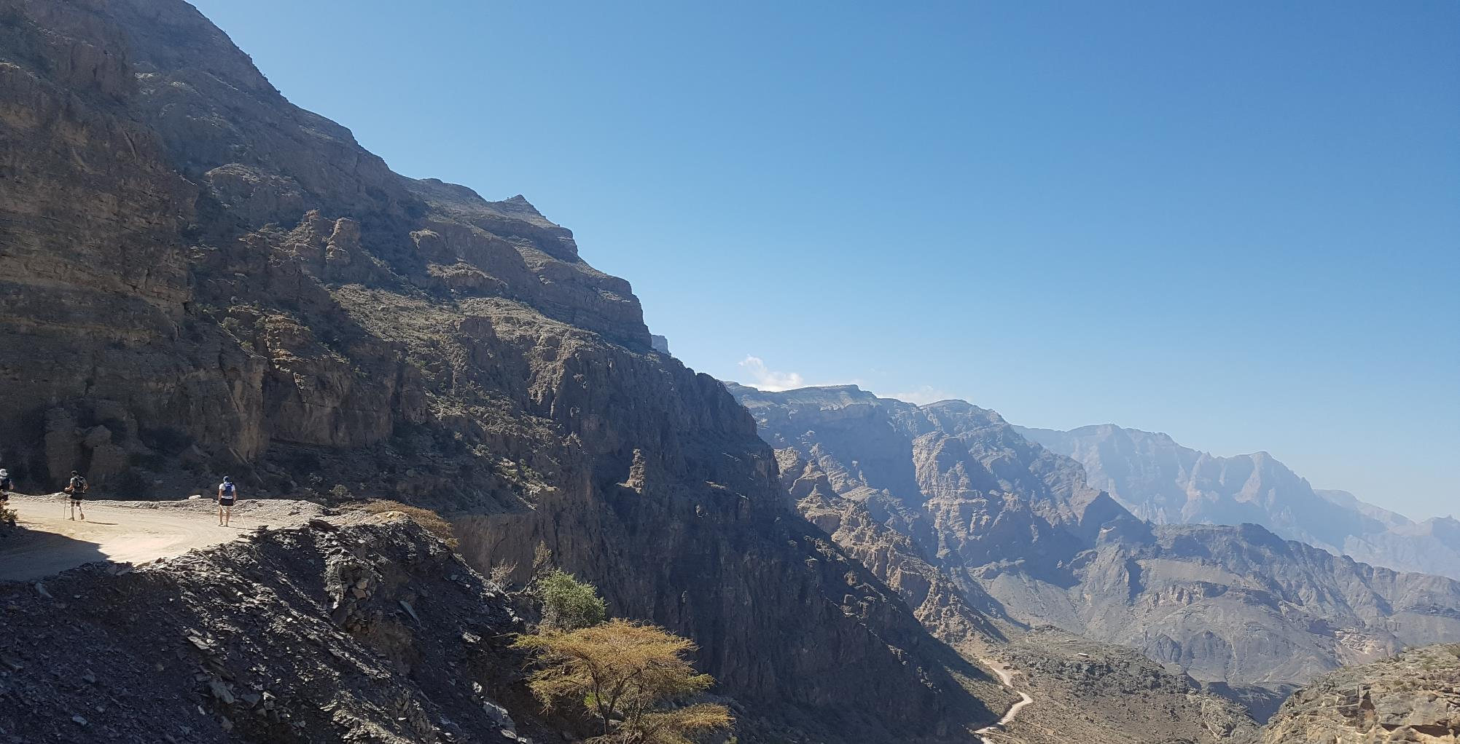
Day 8
Salmah plateau - hiking

Slide 17
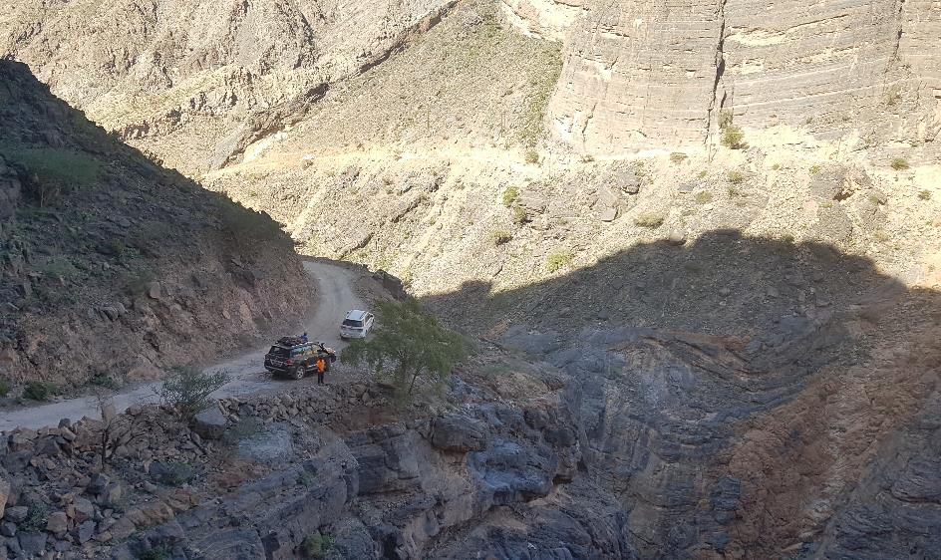
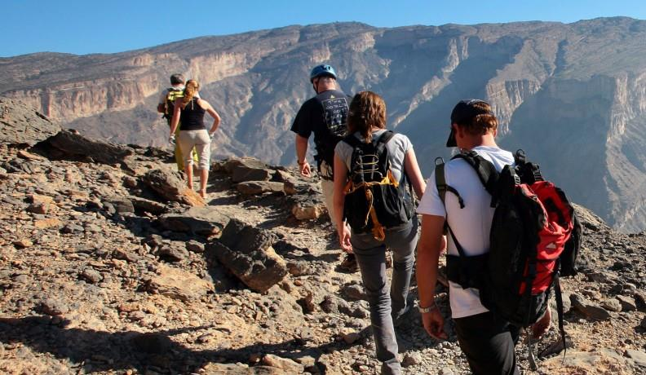
Day 8 of 9
Enjoy your breakfast at the camping site
Your hike covers approx. 40km on the Salmah plateau
A mountain trail offers panoramic scenery
Pause for lunch
Post lunch, drive back to Muscat and check-in to your hotel
Unwind this evening after your adventurous journey through the Omani heartland

Slide 18
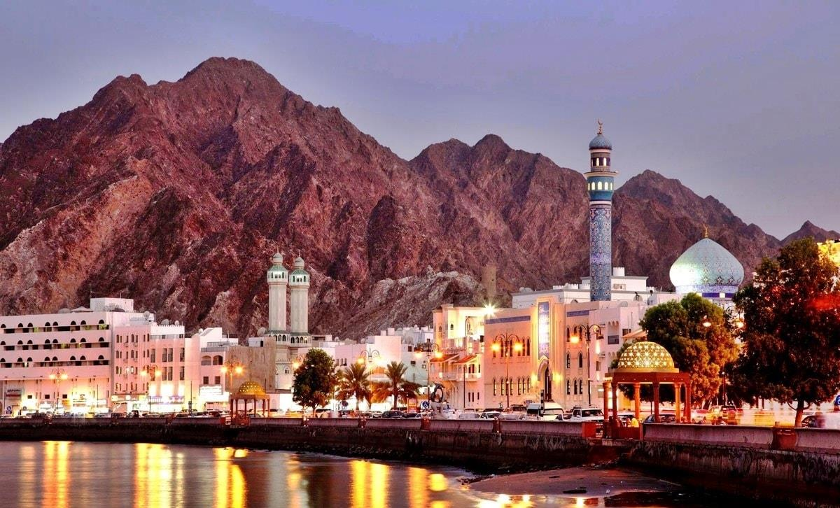
Day 9
MUSCAT

Slide 19
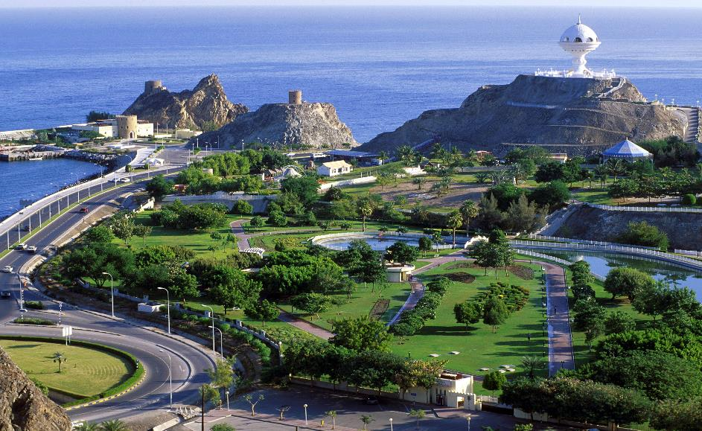
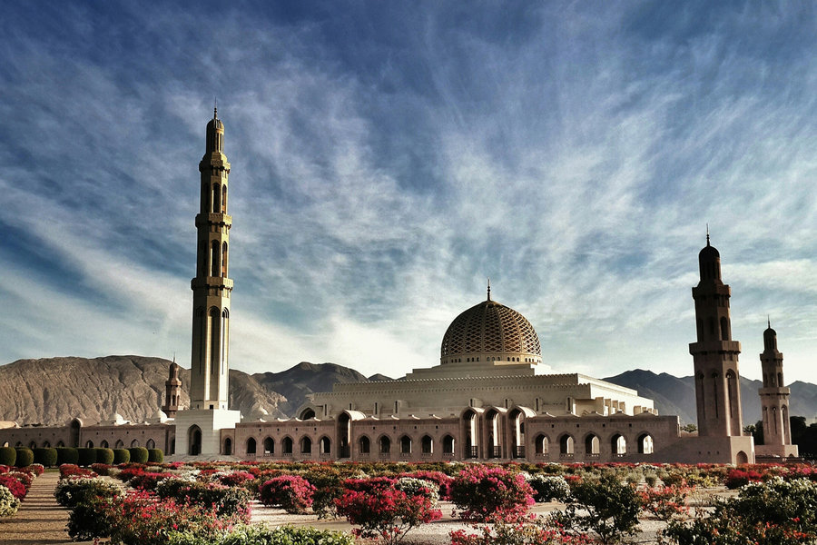
Day 9 of 9
A relaxed day at leisure
Enjoy breakfast at the hotel; afterwards try out the Spa or enquire with us for optional excursions
Explore the city at your pace. Check out by noon and transfer to Muscat International Airport per your flight schedule
Hope to meet you again!

Slide 20
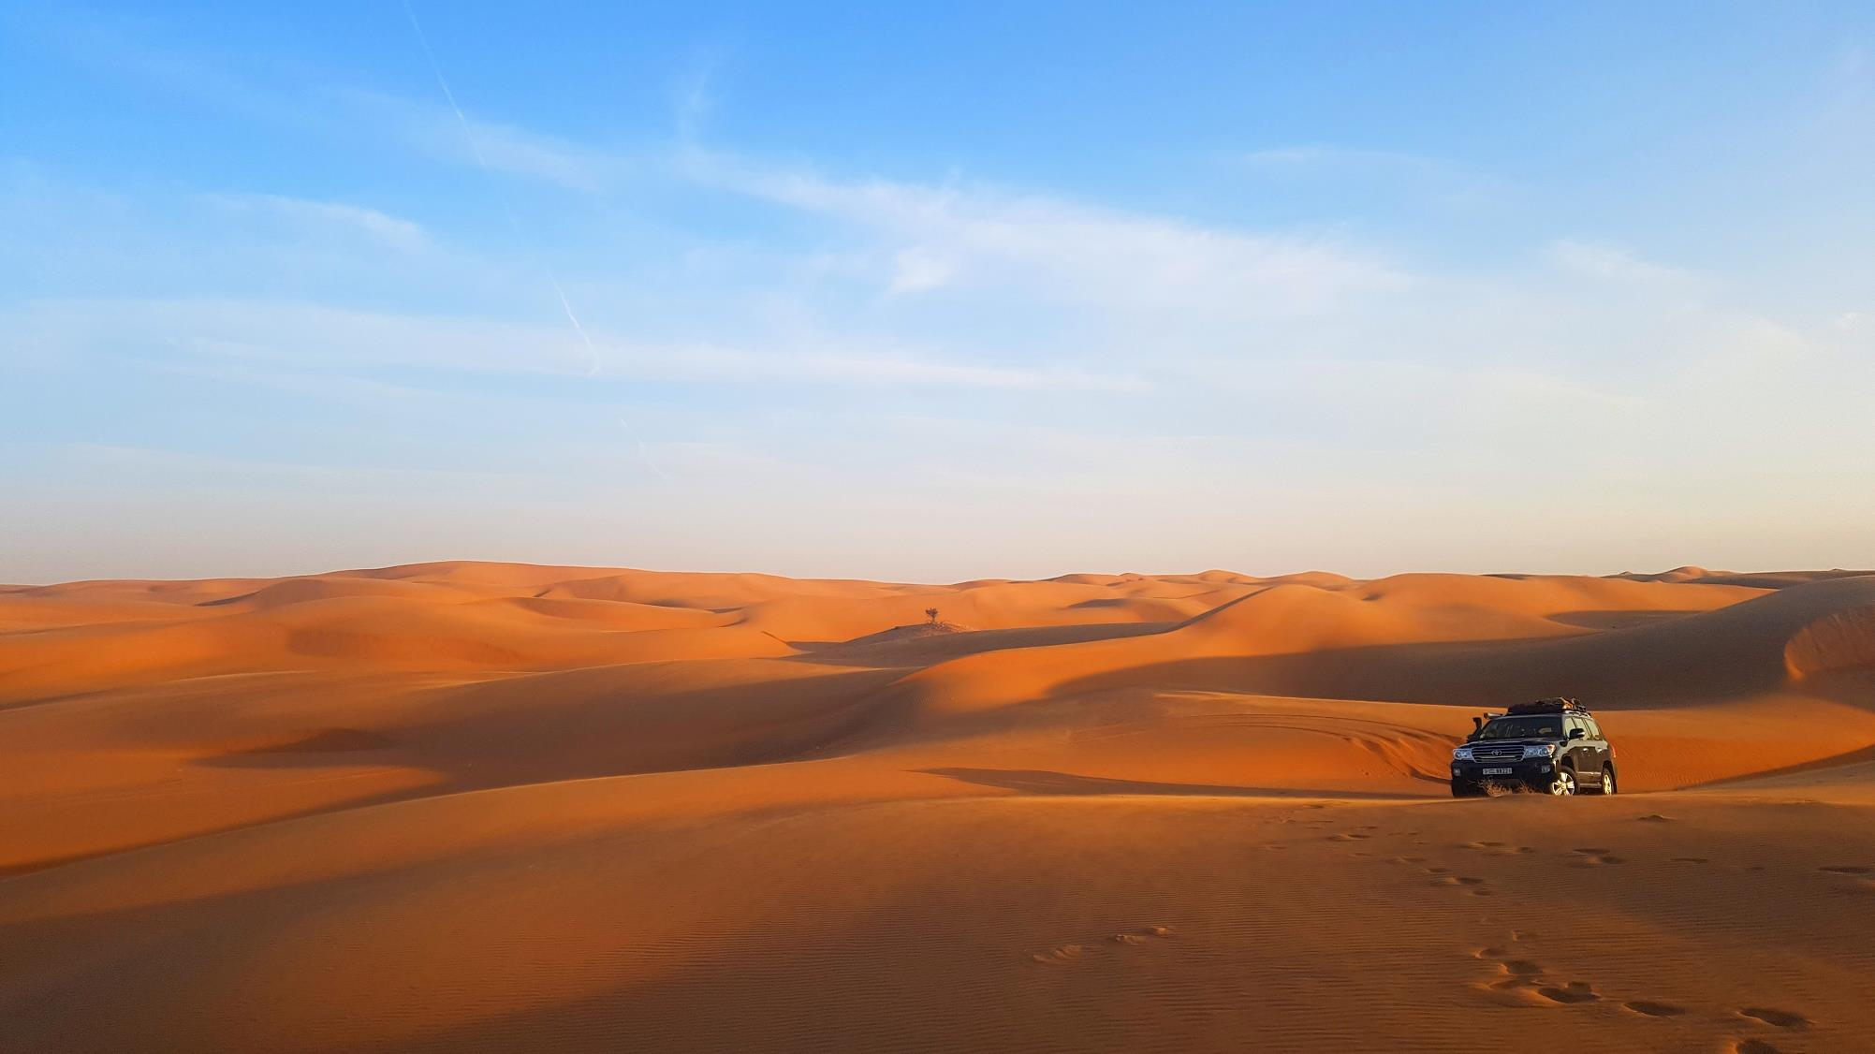
Whilst all Orient journeys are different, each of them at its heart is about experiencing the best of Oman's environment and culture, as well as getting to know the local people. As a result, we do our best to ensure that our presence is as beneficial as possible for both the local environment and its inhabitants.
When we arrive to set up camp, we always clean the surrounding area first, restoring it to pristine condition and do the same when we leave.
Orient journeys are always keen to support and promote local craftsmen, buy fresh fish from local fishermen and employ local guides and experts.

Slide 21
Thank You!
FOR BOOKINGS, PLEASE CONTACT: roy@orienttours.ae +971 6 5682323

